Slide 1
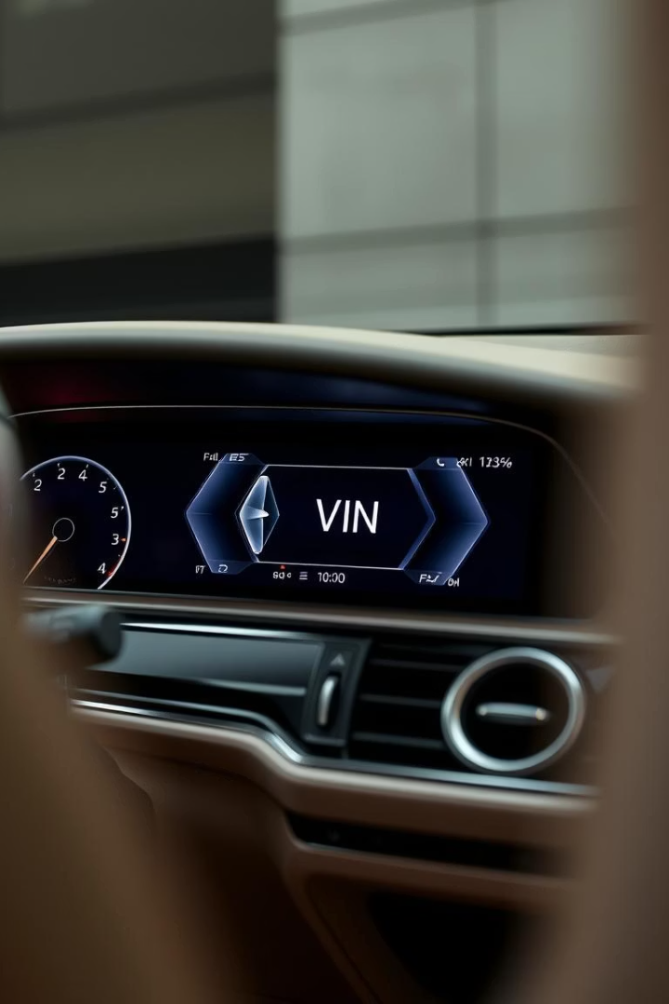
AI-Based VIN Check System
Marlen Zhaksylyk

Slide 2
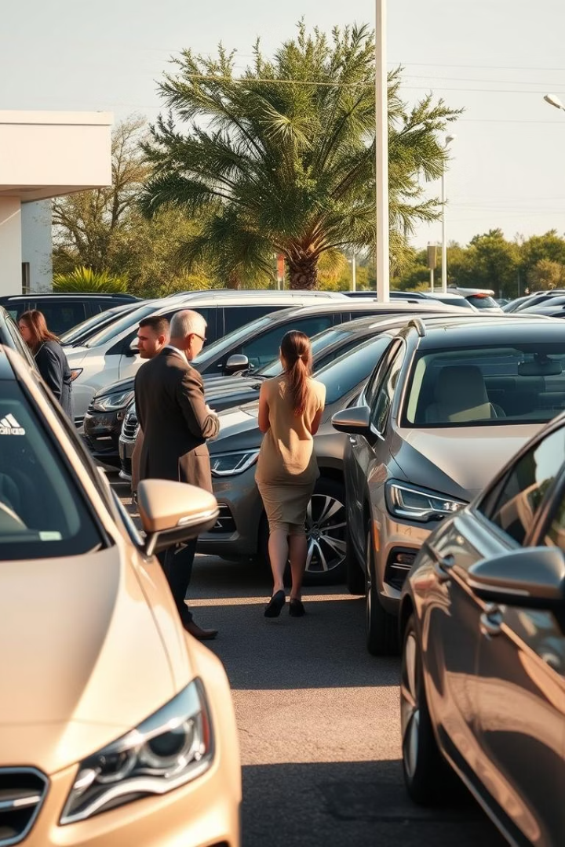
Risks When Buying Used Cars
Hidden Accidents
Mileage Fraud
Undisclosed damage history
Manipulated odometer readings
Untrustworthy Sellers
Lack of transparency

Slide 3
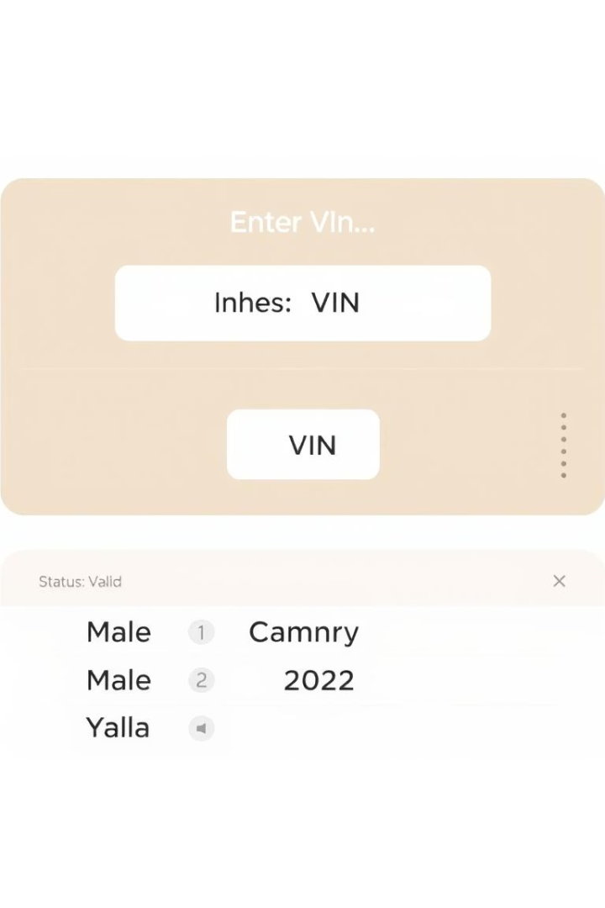
AI-Powered VIN Validation Web App
Built with Python & Flask
AI rule-based validation
Follows ISO 3779 standard

Slide 4
VIN Validation Rules
Exactly 17 characters
Exclude I, O, Q to prevent confusion
Allowed letters & digits only
Based on ISO 3779 international standard

Slide 5





User Workflow Overview
User enters VIN
System analyzes structure
AI outputs Valid or Invalid
Instant result displayed online

Slide 6
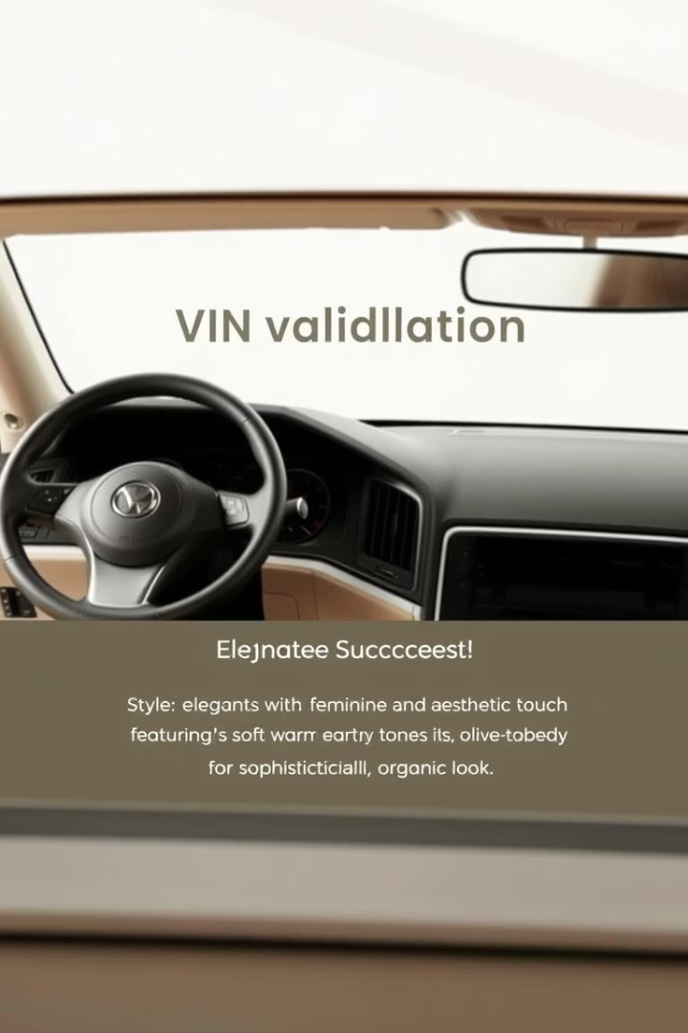
System Testing and Interface
Real VIN testing
Accurate format detection
User-friendly design

Slide 7
Privacy and Data Handling
No data stored
Privacy ensured
Local processing only
Real-time feedback
Future: disclaimer & data policy

Slide 8
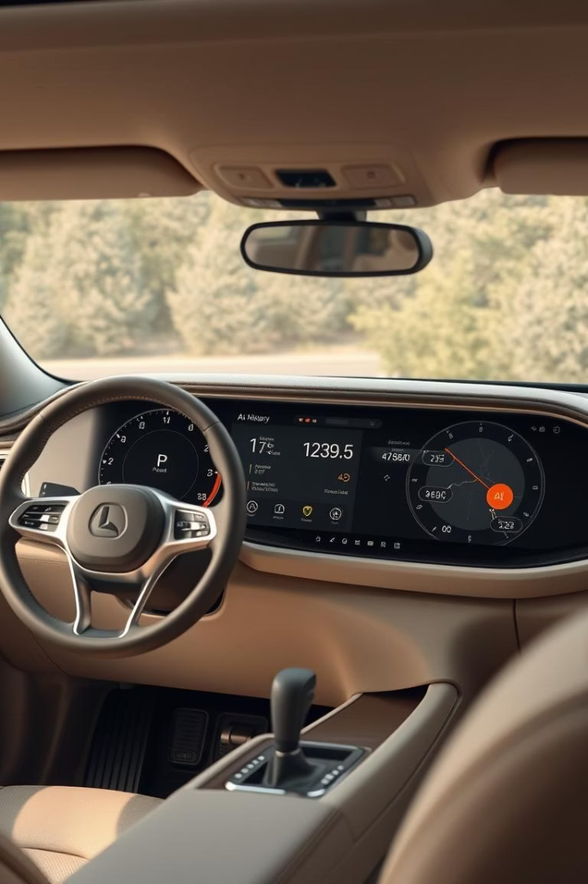
Project Status & Future Features
Current: AI-powered prototype
Future: Full car history access
Detect odometer rollback
Flag stolen or damaged cars

